Slide 1

Daily Deals Promotion Analysis

Slide 2
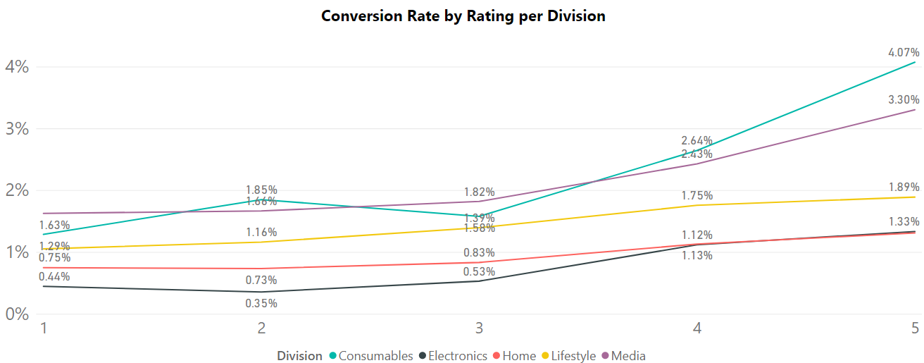
The story of Daily Deals products rating and their conversion rate
Inflection point
The daily deals conversion rate starts changing concavity at 3-star product rating across all Divisions.
Consider briefing into daily deals products with 4-5 start rating.

Slide 3
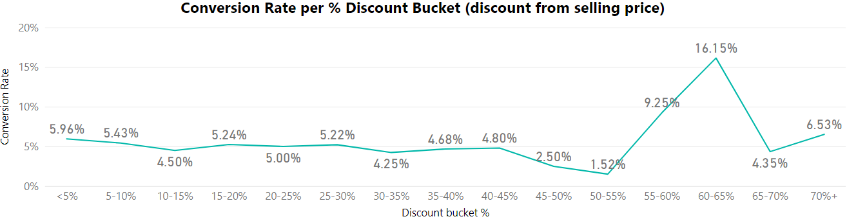
Daily Deals overall conversion rate per % discount bucket
(discount from selling price)
Inflection point
Inflection point
Inflection point

Slide 4
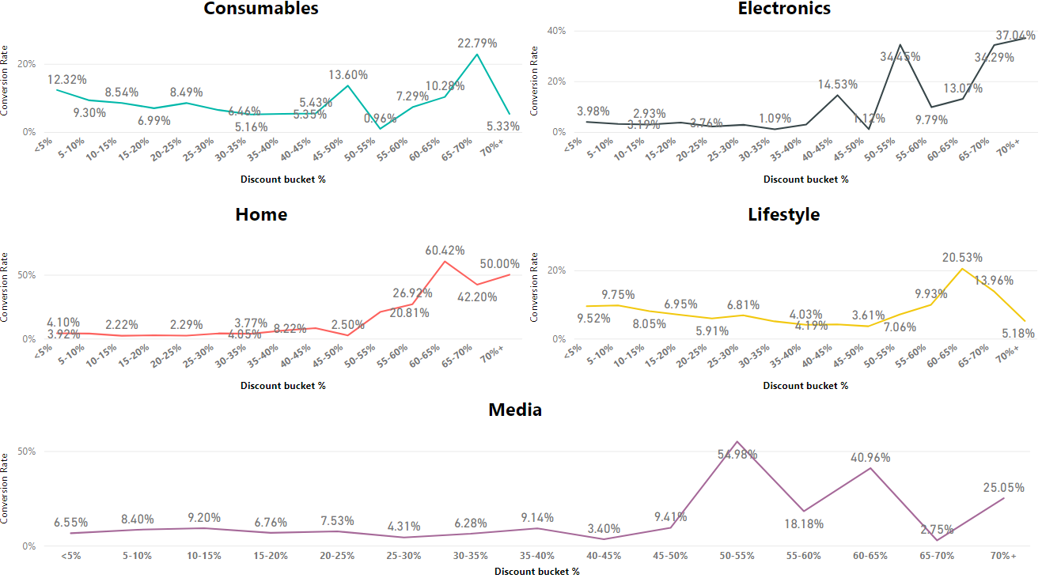
Daily Deals Conversion rate per % discount bucket
(discount from selling price) for each Division
Inflection point
Inflection point
Inflection point
Inflection point
Inflection point

